Slide 1
19CSE205 Program Reasoning Introduction
Dr.S.Padmavathi
CSE, Amrita School of Engineering
Coimbatore

Slide 2
Waterfall Model of Software Development
Req Analysis
Design
Implement
Test
Deploy

Slide 3
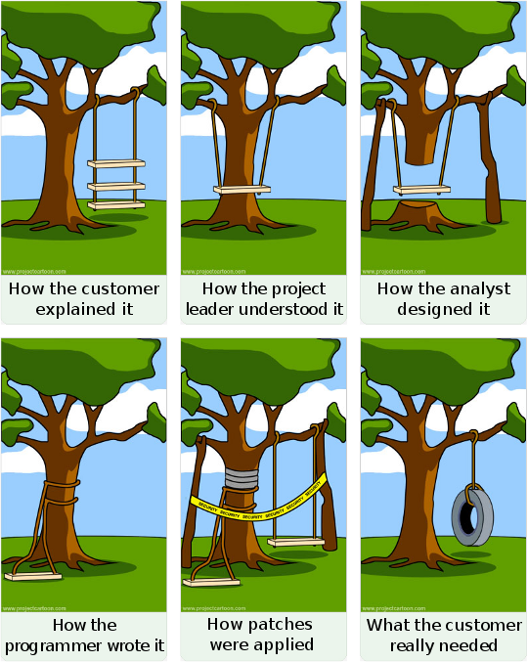
Software Development

Slide 4
Software Defects
Software defects hard to detect and fix, and can be costly
Small software bugs have resulted in major system failure
Testing and finding bugs contribute to major portion of the software development and maintenance costs
Types of Errors
Low-level Errors
e.g null pointers, array index out of bounds, unreachable code etc
High-level Errors
Algorithmic and design errors, inefficient code, incorrect logic

Slide 5
Consequences of Software errors
Can result in loss of billions of dollars
NASA’s Mars Climate Orbiter lost in space
In 1998 NASA’s Climate Orbiter spacecraft could not stabilize its orbit around mars
Reason
conversion from English units to metric not done !!!!
Reference: Dr. Vidya Balasubramanian, Program reasoning course.

Slide 6
Consequences of Software errors
Ariane 5 Flight 501
Europe’s un-manned satellite-launching rocket exploded within minutes of launch
reused working software from its predecessor
64-bit number was converted into a 16-bit number
Overflow condition resulted in crash of both primary and secondary computers
Cost more than $500 million

Slide 7
Consequences of Software errors
Disruption to daily activities and loss of money
Y2K problem
Heathrow Disruption : February 2020
100s of flights to and from London’s Heathrow Airport disrupted Feb 16th 2020
Issues in check-in boards and departure systems
Insurance Mess
8500 declared dead but weren’t
Software bug in patient database in a hospital in Grand Rapids, Michigan
Mapping error in disposition code - “20” was assigned instead of “01” — “dead” instead of “discharged”
Reference: Dr. Vidya Balasubramanian, Program reasoning course.

Slide 8
Consequences of Software errors
Loss of lives!!
Patriot Missile Error
In 1991 the Patriot missile system failed to detect a missile resulting in 28 fatalities
Inaccurate tracking calculation, with error accumulation over time
Failure in Panama Cancer Institute and Therac 25
Patients received an overdose of radiation and patients died
Computer controlled radiation therapy machine
Due to arithmetic overload, the system generated a number that was too high for operations
Reference: Dr. Vidya Balasubramanian, Program reasoning course.

Slide 9
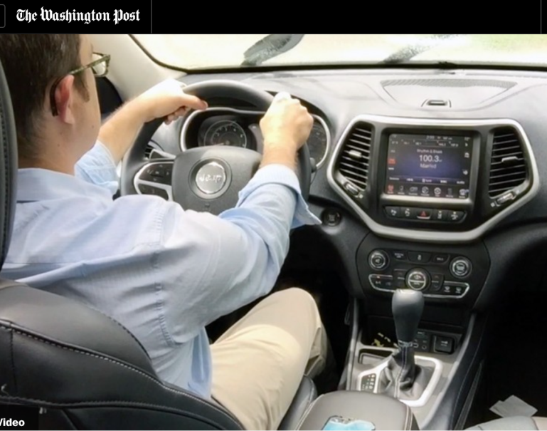
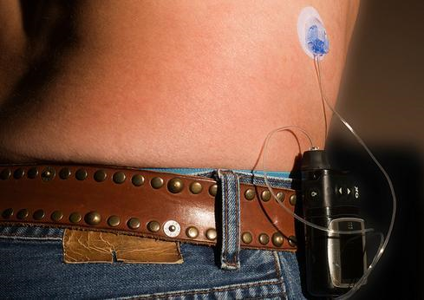
Need for Safe Software
Security Threat and hacking wireless enabled devices
Medical device Insecurity:
Insulin Pumps are amenable to cyber attack
Hacking into Automobiles
The Jeep Cherokee was hacked through its wireless network.

Slide 10
Software Testing
Software testing is an approach to identify and correct software errors
A set of test cases created based on the application and executed
The code is checked for its expected behavior (ie.) does it produce the expected output for the given set of input.
Black Box Testing
White Box Testing
Gray box testing

Slide 11
Software testing- Black box testing
Function f:
Input: 3 numbers
Output: 1 number
Code
f (int a, int b, int c)
{
….
}
Printf(“%d”,output);
Input: 5,3,1
Output: 5
Input: 2,19,8
Output: 19
Input: 4,9,33
Output: 33

Slide 12
Black box Testing
Known as behavioral testing
inner details of the software not known
Can find behavioral errors, incorrect functions, interface errors, performance errors, termination issues etc

Slide 13
Software testing-White/ Gray box
Greatest of three numbers
Code
Input: 5,3,1
Output: 5
Input: 2,19,8
Output: 19
Input: 4,9,33
Output: 33
Input: 26,19,77
Output: 26
Greatest(int a, int b, int c)
{
If( a>b)
G=a;
Else if(b>c)
G=b;
Else
G=c;
}
Printf(“%d”,G);

Slide 14
White Box Testing
Internal structure of program known to user
Based on analysis of components of the software
e.g unit testing, integration testing

Slide 15
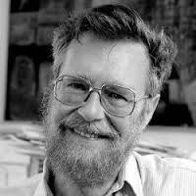
Limitations of Software Testing
Software Testing is difficult due to large number of:
input combinations;
execution paths in code;
interleavings of threads;
Complexity of software and operating environment also
make testing difficult.
“Program testing can be used
to show the presence of errors,
but not their absence.”
- Edgser W. Dijkstra
Reference: Dr.Bharat Jayaraman, Unviversity of Buffalo, CSE449-459 Software verification course, Spring 2020.

Slide 16
Program Verification
“The algorithmic discovery of properties of a program by inspection of the source text”-- “Algorithmic Verification”
Also called static analysis, formal verification etc
Goal: Automatic verification is not about proving correctness, but about finding bugs much earlier in the development of a system

Slide 17
Software Testing vs Verification
Software Testing (Run-time):
Run the software on a suite of test cases and
check that the outputs are correct (functional) and
it works as expected (behavioral).
Software Verification (Design-time):
Prove that the software is correct with respect to
given specifications – functional and behavioral –
using algorithmic or interactive methods.
Reference: Dr.Bharat Jayaraman, Unviversity of Buffalo, CSE449-459 Software verification course, Spring 2020.

Slide 18
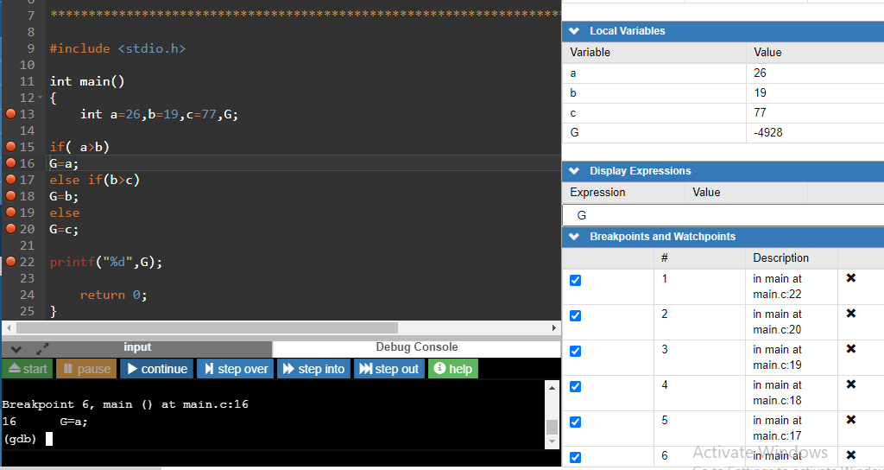
Debugging

Slide 19
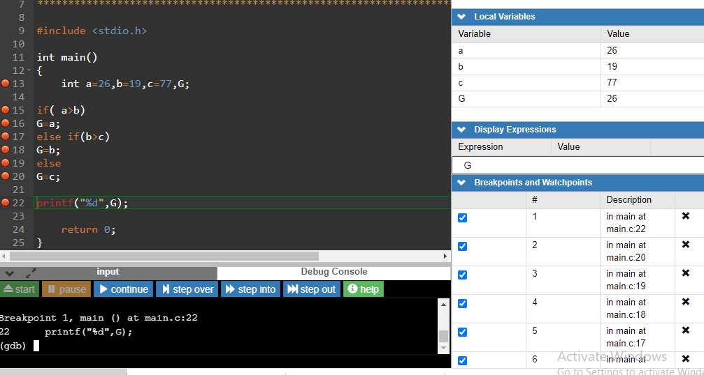
https://www.onlinegdb.com/online_c_debugger#

Slide 20
Verification vs Debugging
Considering a model M of a software system,
debugging approach:
tries to find errors in a model M
verification approach:
tries to ascertain the correctness of a detailed model M of the system under validation
Model checking is most effective in combination with the debugging approach

Slide 21
Course overview
This course introduces program verification and reasoning for both sequential and parallel systems
The course aims at developing the ability to reason about program’s correctness from a formal stand point.
It gives an introduction to tools and techniques to ascertain functional and behavioural correctness for sequential as well as concurrent programs.
Course Outcomes
CO1: Understand the necessity of proving correctness of programs with respect to formal specification or property
CO2: Apply program verification techniques to prove and analyze correctness of programs.
CO3: Understand the problems associated with concurrent programs and their effects on their behavioural correctness
CO4: Understand and use few state-of-the-art tools to model and verify sequential and concurrent systems.

Slide 22
Syllabus
Verification of sequential programs
Proving correctness of sequential programs using weakest preconditions: rules and application examples
Loop invariants, partial correctness and total correctness
Verification of Sequential programs using tools like Alt-Ergo, FRAMA-C
Verification of Advanced Structures and Algorithms
Application of Verification techniques in linear data structures
Modeling and Verifying Concurrent Programs
Specifying temporal properties using linear temporal logic and operators
Model checking using SPIN/Promela
Behavioral correctness of concurrent programs: safety and liveness properties
Application examples.

Slide 23
Materials and Text books
Course Materials in AMPLE
Extra materials will be uploaded in AMPLE
Textbooks
Ben-Ari M. Principles of the Spin model checker. 2008 edition, Springer Science & Business Media; 2008.
Huth M, Ryan M. Logic in Computer Science. Second Edition, Cambridge University Press; 2004.

Slide 24
Evaluation
Evaluation pattern
Quizzes - 20%
Assignments - 30%
Lab Evaluations - 20%
End Semester - Online Exam and Viva - 30%

